Slide 1
Introduction to Data Management
Data Management
DTS 304

Slide 2
By the end of this class, students should be able to:
Explain the difference between data and information.
Describe why organisations need to manage data properly.
Explain the basic idea of a database and a Database Management System (DBMS).
Recognise common problems such as duplicate records, missing values and unauthorised access.
Design a simple database for a real-life situation.
What we will learn today

Slide 3
Imagine that NUTM-CS department has 50 students. Their names, registration numbers, courses and examination scores are kept in different spreadsheets.
Some students change their phone numbers. A lecturer corrects a score, but the departmental copy is not updated. Two students have similar names, and one student's registration number is entered incorrectly.
Discuss:
What problems could arise?
Which record should be trusted?
How would the department find one student's information quickly?
Who should be allowed to change examination scores?
4

Slide 4
What is data?
Data refers to recorded facts, values or observations.
Data may be written on paper, stored in a spreadsheet, kept in a database or collected by a computer system.
Data is useful, but it often needs to be organised and interpreted before it can answer a question.

Slide 5
Data: individual facts or recorded values.
Information: data organised or interpreted to answer a particular question.
Example;
24, CS, NUTM
6

Slide 6
Why do we manage data ?
Organisations manage data because they need to:
Keep accurate records.
Find information without wasting time.
Avoid unnecessary duplication.
Update records when circumstances change.
Produce reports for planning and decision-making.
Control who can view or change information.
Preserve important records and recover them when something goes wrong.

Slide 7
Data management is the process of collecting, organising, storing, maintaining, retrieving, using and protecting data throughout its period of use.
It involves more than storing information on a computer.

Slide 8
Data Management Process
Capture
Organise
Store
Maintain
Retrieve and use
Protect and retain
The process is continuous. Data may need to be updated, checked or retrieved many times.

Slide 9
Where is data management used?
Education, Healthcare, Banking, Retail, Transport, Government, etc.
10

Slide 10
Consider this problems ?
The same student appears twice.
Some registration numbers are missing.
Dates are written in different formats.
One lecturer has an old copy of the file.
Examination results can be changed without authorisation.
Nobody knows whether the latest backup works.
11

Slide 11

Data can be stored in different ways.
Paper records: useful for some manual processes, but searching, sharing and updating large collections can be difficult.
Files: data may be stored in text files or other formats. The organisation of records depends on how the files are designed and maintained.
Spreadsheets: useful for calculations, lists and small datasets. Problems can arise when many users maintain separate copies or when the data becomes complex.
Databases: organise related data so that it can be stored, searched, updated and managed systematically.

Slide 12
What is a database?
A database is an organised collection of related data.
For example, a university database may contain information about:
Students
Departments
Courses
Lecturers
Course registrations
Examination results
13

Slide 13
What is a Database Management System?
A Database Management System (DBMS) is software used to create, manage and work with databases.
Examples include MySQL, PostgreSQL, MicrosoftSQL Server and Oracle Database
14

Slide 14
A DBMS can help users:
Define the structure of a database.
Insert, retrieve, update and delete records.
Enforce rules on the data.
Control access to information.
Allow multiple users to work with data.
Support backup and recovery.
.
15

Slide 15
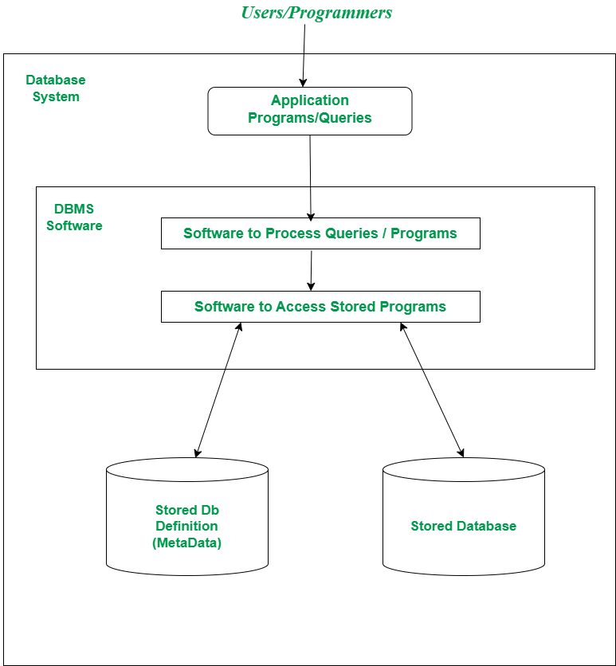
DB System Environment

Slide 16
Next Week;
Introduction to the relational database
23

Slide 17
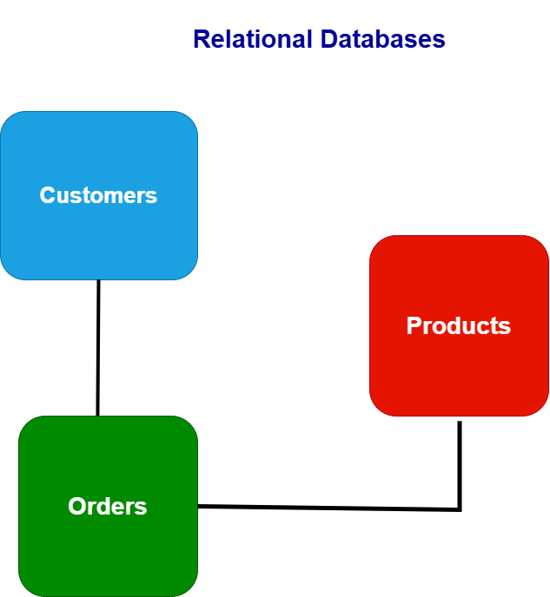

Slide 18
CREATE TABLE students (
matric_no TEXT,
dept TEXT,
gender TEXT,
contact TEXT
);

Slide 19
INSERT INTO students VALUES ('CS/001', 'Computer Science', 'Male', '08012345678');
INSERT INTO students VALUES ('ENG/002', 'Engineering', 'Female', '08098765432');
INSERT INTO students VALUES ('MED/003', 'Medicine', 'Male', '08055555555');
INSERT INTO students VALUES ('LAW/004', 'Law', 'Female', '08044444444');
INSERT INTO students VALUES ('ART/005', 'Arts', 'Male', '08033333333');
SELECT *
FROM students;

Slide 20
SELECT *
FROM students
WHERE gender = 'Female';

